Slide 1



Beyond the Cart
View in Power BI
Last data refresh:
11/28/2024 5:26:48 AM UTC
Downloaded at:
11/28/2024 5:35:54 AM UTC

Slide 2
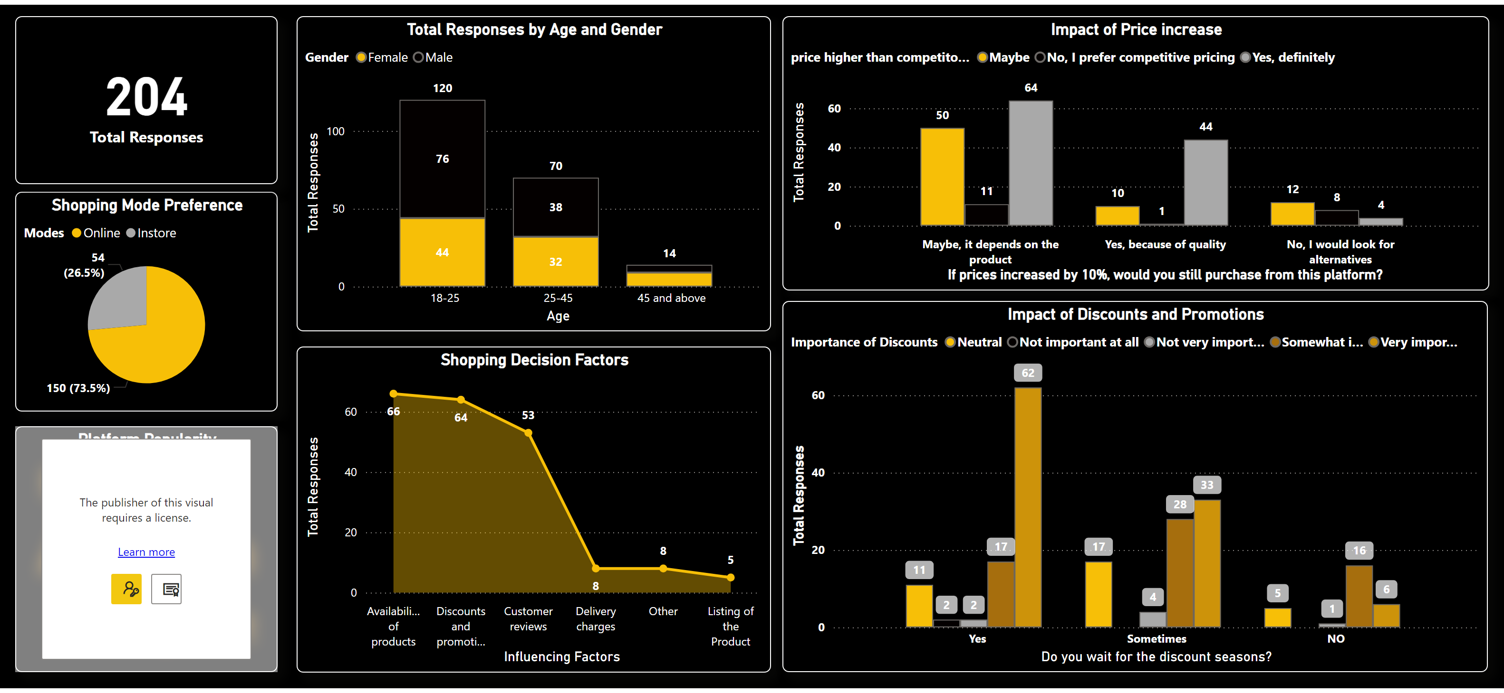
Page 1
Notes:
columnChart
No alt text provided
Shopping Mode Preference
No alt text provided
Shopping Decision Factors
No alt text provided
Impact of Price increase
No alt text provided
Impact of Discounts and Promotions
No alt text provided
Platform Popularity
No alt text provided
No. of Responses
No alt text provided

Slide 3
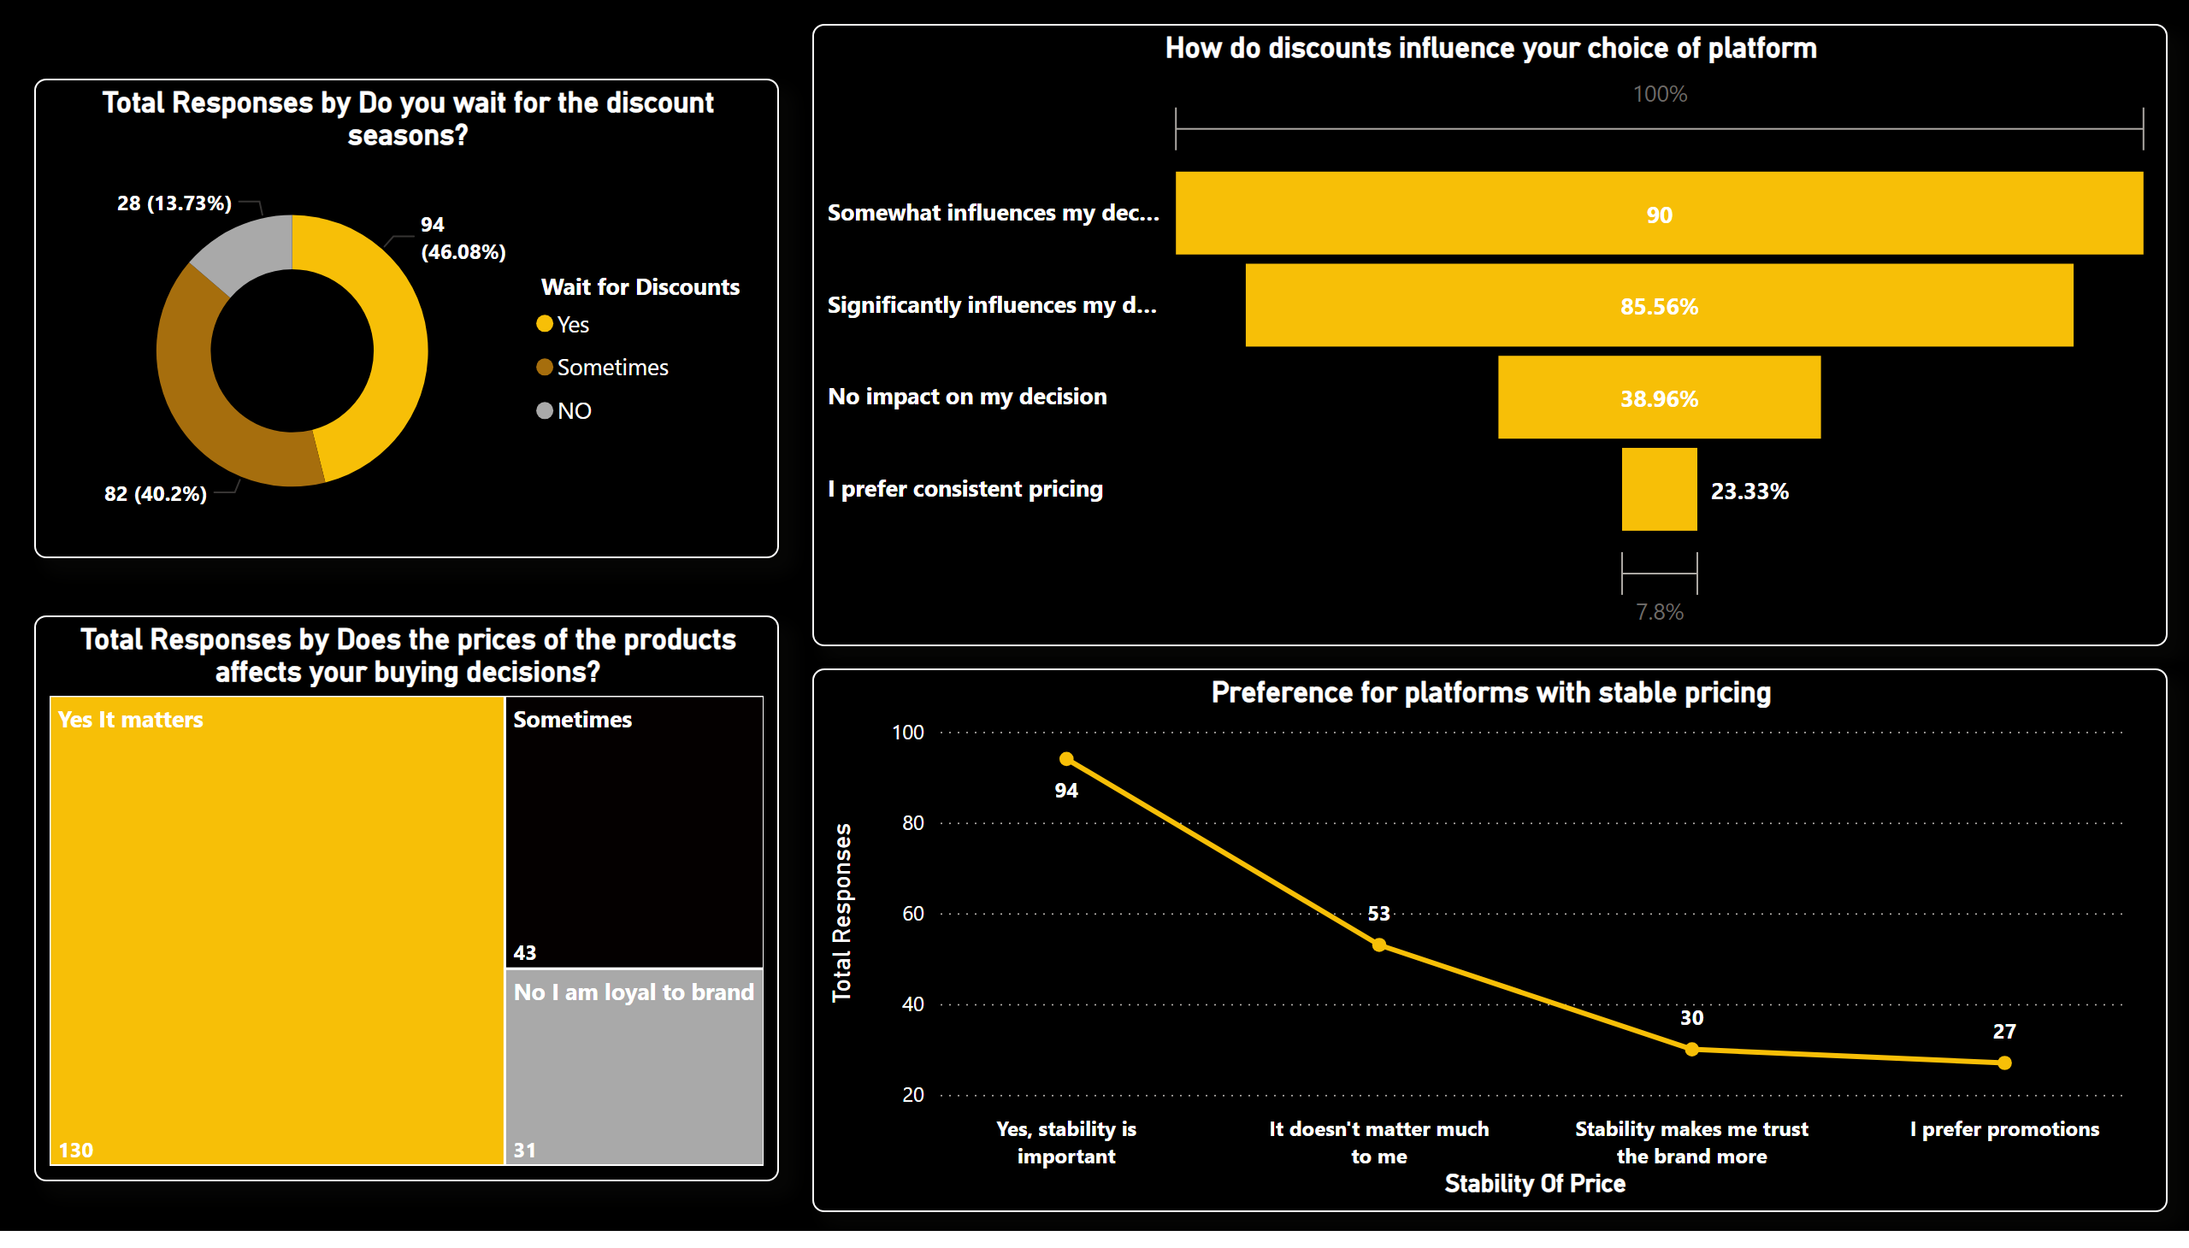
Page 2
Notes:
How do discounts influence your choice of platform
No alt text provided
donutChart
No alt text provided
Preference for platforms with stable pricing
No alt text provided
treemap
No alt text provided

